Slide 1


Hackfest 2024
(12th Feb, 2024)
University of Engineering and Management, Kolkata
Traveller’s Treasure
Theme Name: SMART TOURISM
Team Name : AI AVENGERS

Slide 2


Outline
Team Members
Introduction/ Motivation
Proposed Method
Results
Conclusion
References

Slide 3
Team Members
Team Leader Name: Soumi Mukhopadhyay
Enrollment No: 12022002028108 Department: CSE (A.I.M.L)
Team Member 1 Name: Souradeep Saha
Enrollment No: 12022002022199 Department: CST
Team Member 2 Name: Sneha Ghorai
Enrollment No: 12022002028193 Department: CSE (A.I.M.L)
Team Member 3 Name: Suvodeep Bhattacharya
Enrollment No: 12022002022198 Department: CST
Team Member 4 Name: Mudabbir Rehan Ansari
Enrollment No: 12022002022197 Department: CST
Team Member 5 Name: Abhijeet Tantubay
Enrollment No:12022002022196 Department: CST

Slide 4
Introduction/ Motivation
At our AI AVENGERS platform, we are committed to revolutionize your travel experience by integrating intelligent solutions to make every moment, every destination, and every adventure seamlessly connected and extraordinary.
This project will help you get the essence of exploring places in a much more smarter
way .

Slide 5
Proposed Method
Our Project utilizes following Software Package :-
HTML (HyperText Markup Language): HTML provides the basic framework and content of a web page.
CSS (Cascading Style Sheets): CSS is used for styling and layout.
JavaScript: JavaScript is a programming language that enables interactive and dynamic features on the client side of a web application in real-time.
Node.js: Node.js is a runtime environment that allows the execution of JavaScript on the server side.
MongoDB: MongoDB is a NoSQL database that is often used in web development projects to store data in a flexible, JSON-like format.
6. Express.js: Express.js is a minimal and flexible Node.js web application framework that simplifies the development of robust and scalable server-side applications.

Slide 6
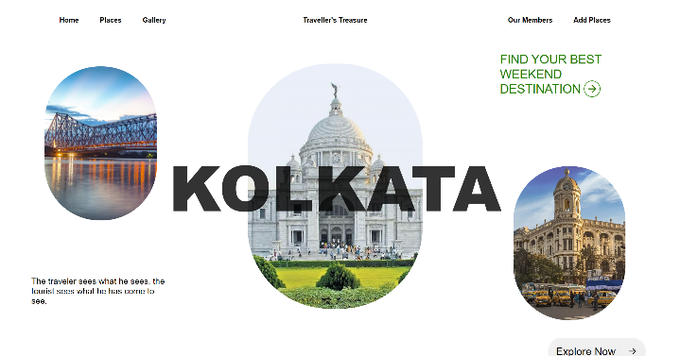
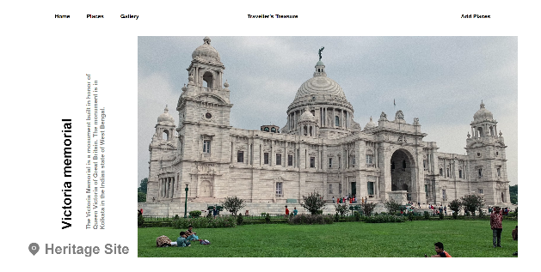
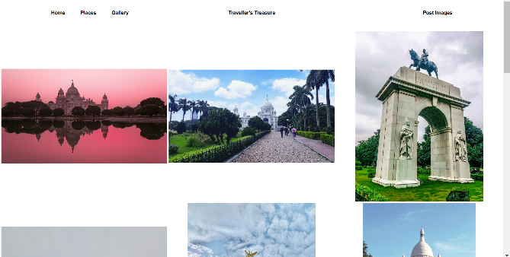
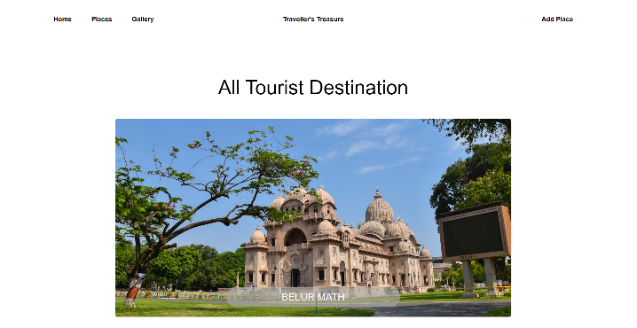
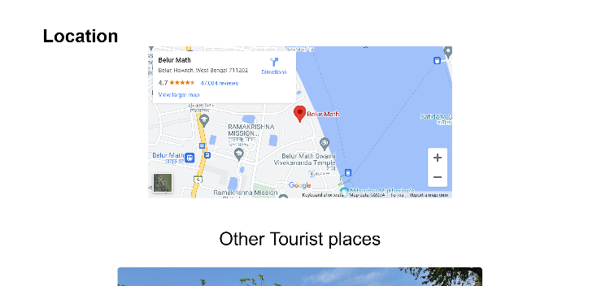
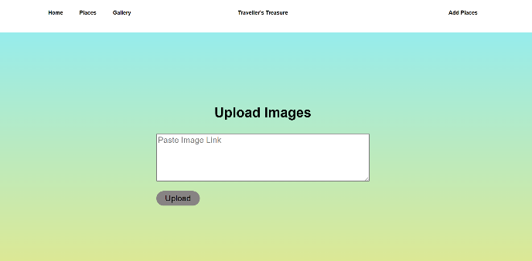
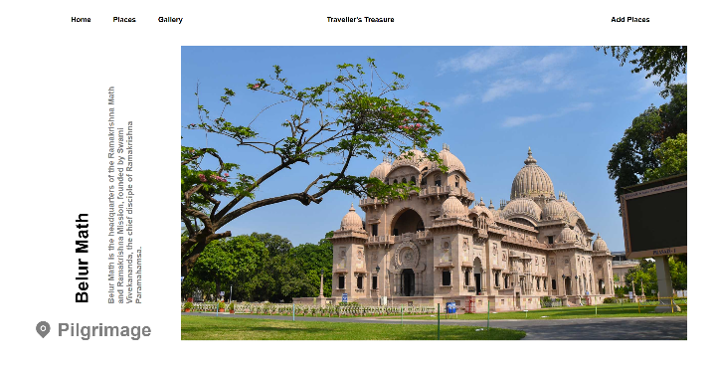
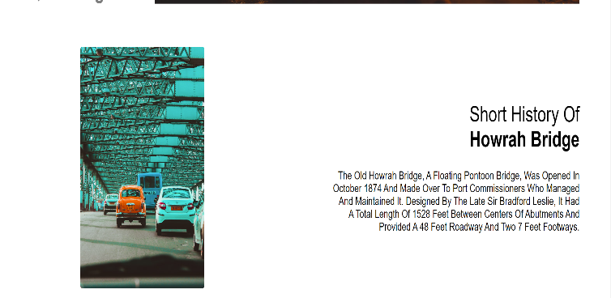
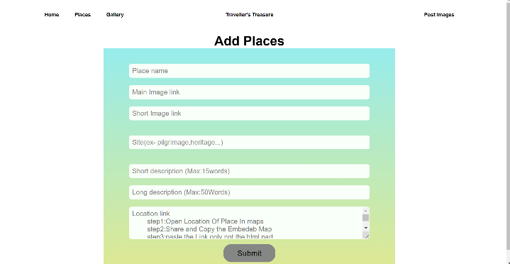
Results and/ or Analysis

Slide 7
Conclusion
To summarize , Smart Tourism is a tech-driven revolution in travel, integrating concepts of EJS,CSS, JAVASCRIPT, NODE,EXPRESS and MONGODB to offer personalized, seamless, and memorable journeys. It transforms traditional exploration into a smart, connected experience, enhancing every aspect of the traveler’s adventure. Our Website Traveller’s Treasure is where innovation meets exploration, creating a future where each trip is intelligently tailored and effortlessly extraordinary.

Slide 8
References
References used in this project :-
Stack Overflow - https://stackoverflow.com/
W3 Schools - https://www.w3schools.com/
Geeks For Geeks - https://www.geeksforgeeks.org/

